Slide 1
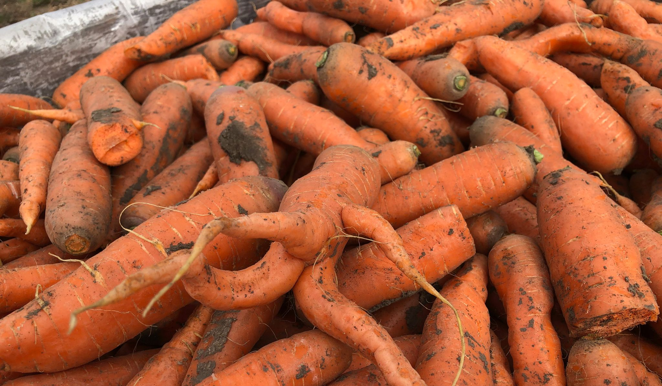
COMMUNITY CARROT PILOT PROJECT

Slide 2
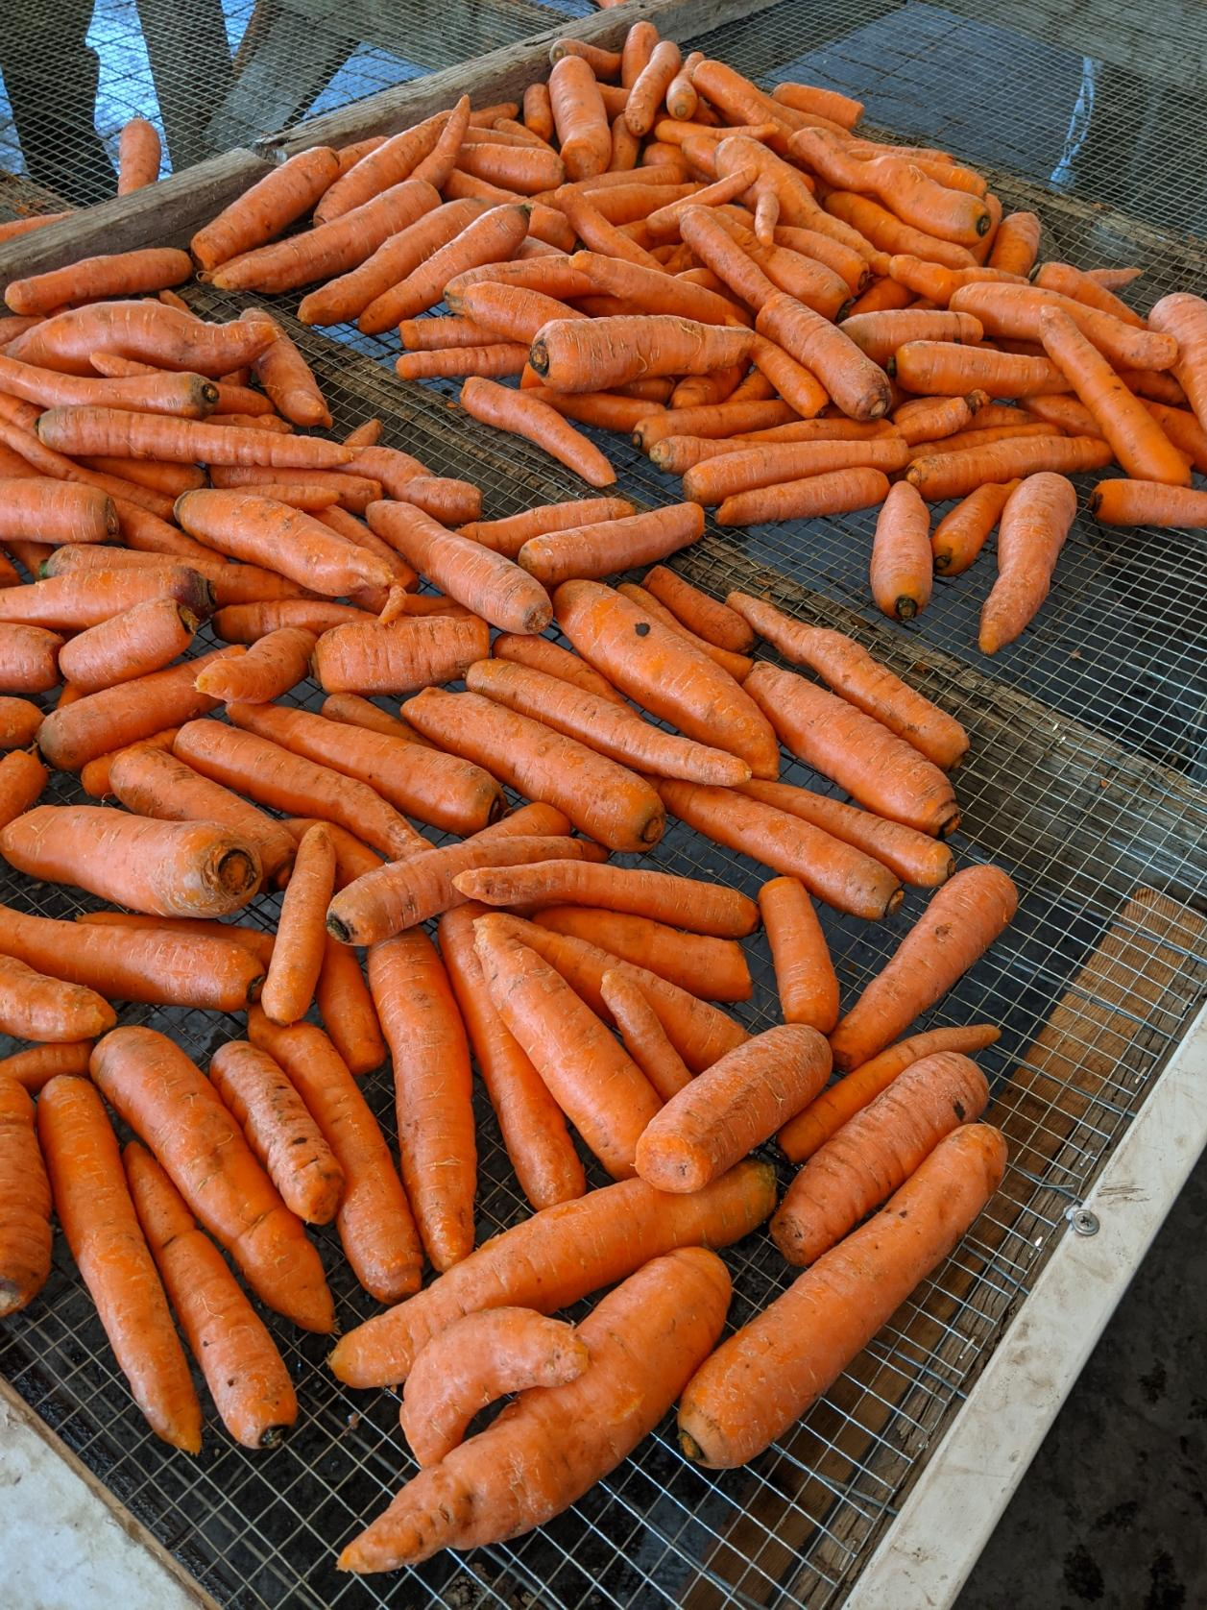
Conception
Coronavirus
Disruption
Need
Isolation
Land
Organic acres
Uncertain fate
Community
Values
Connection

Slide 3
Vision + Action
Jacy Rothschiller sporting Red Ants Pants
—photo compliments GVB facebook, Red Ants Pants photo-shoot

Slide 4
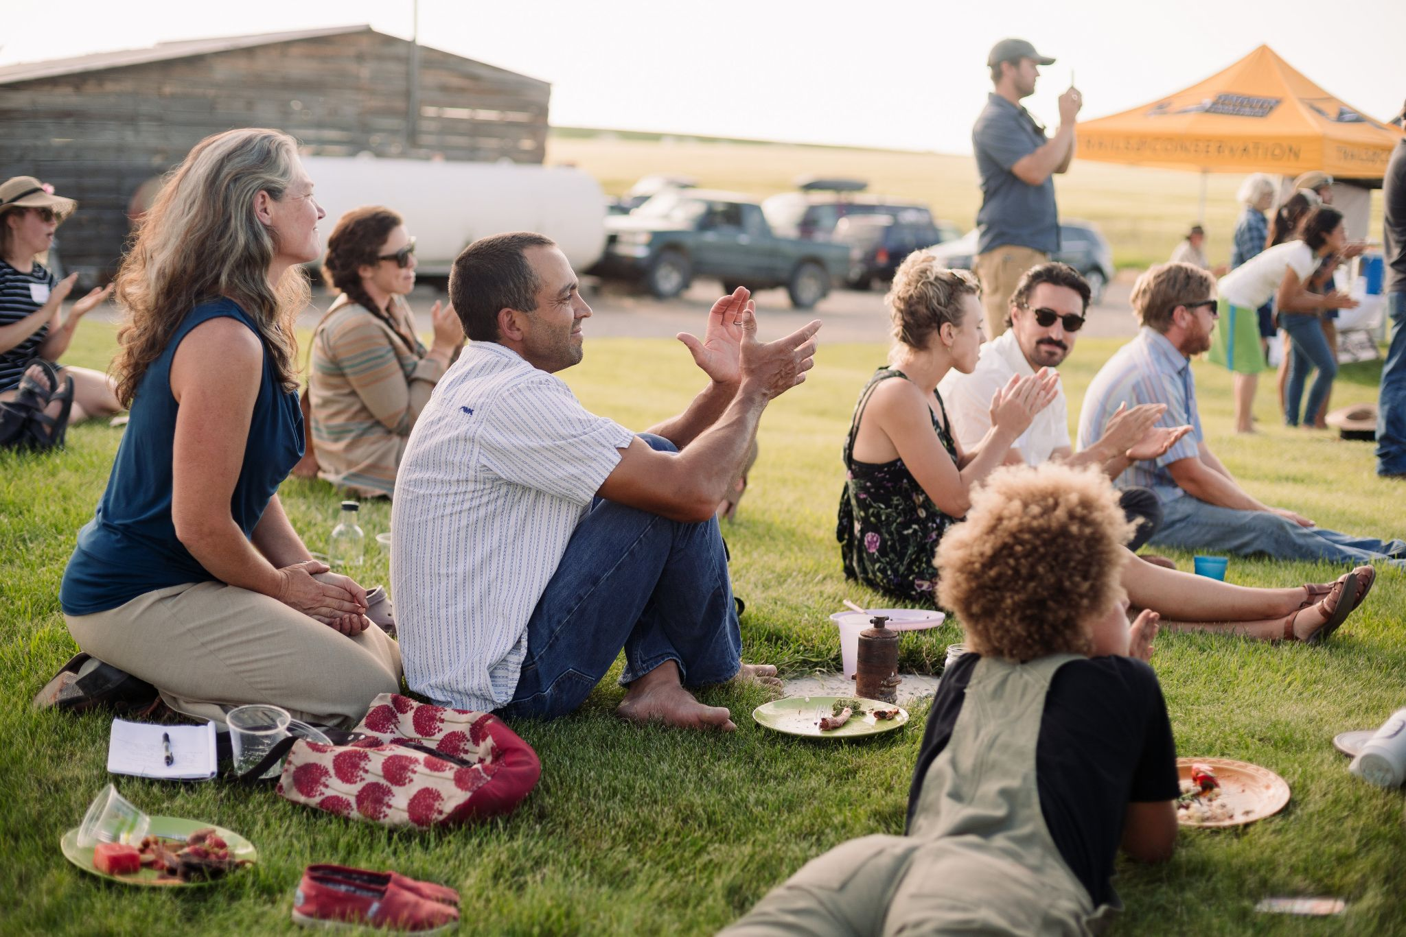
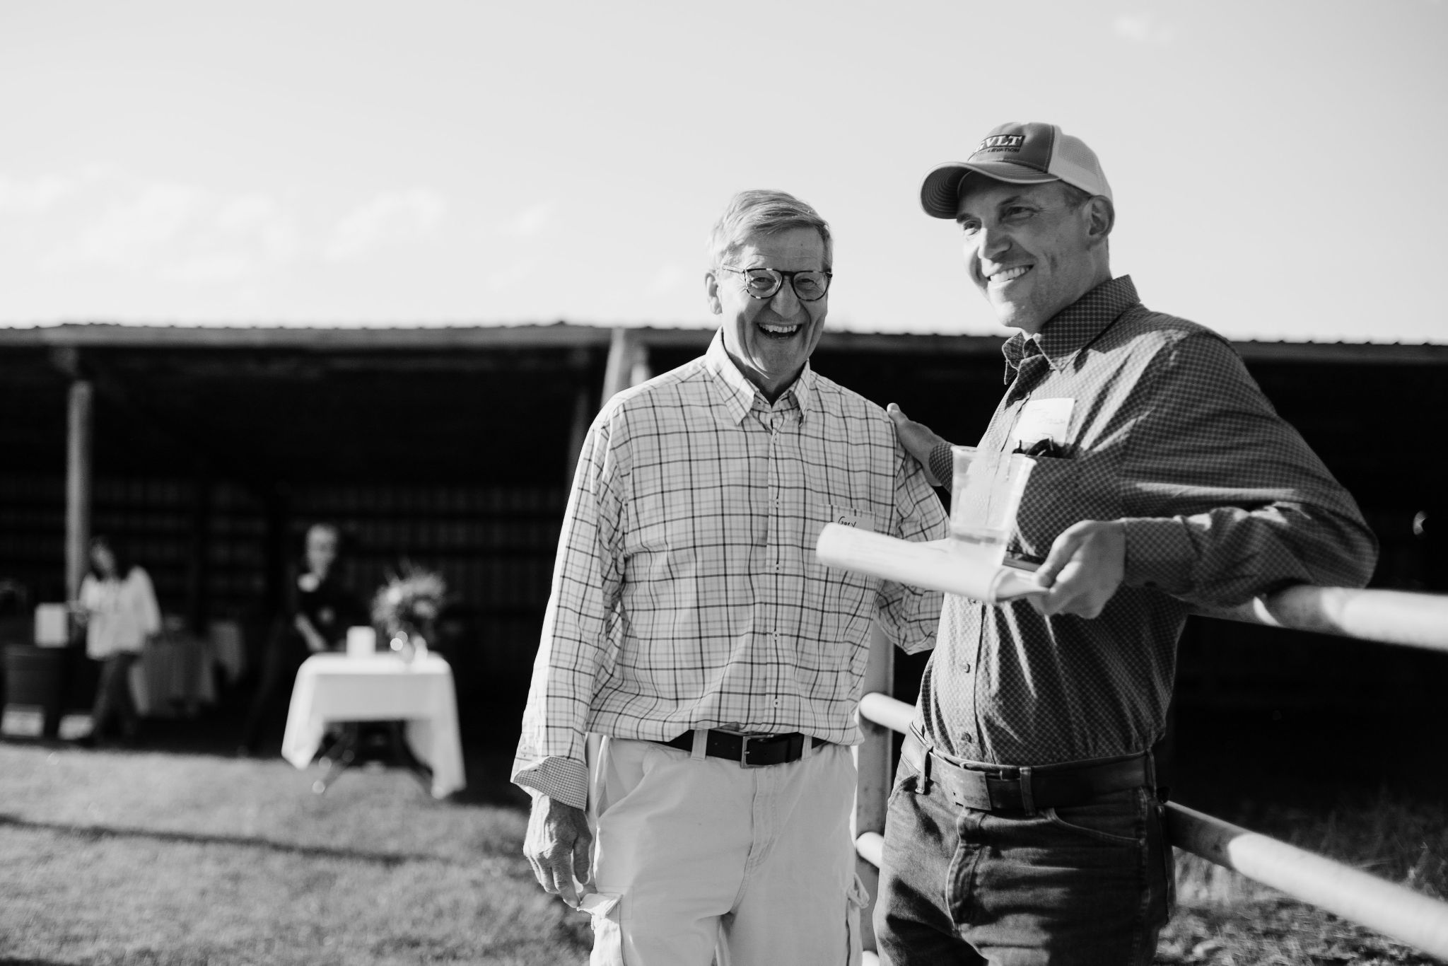
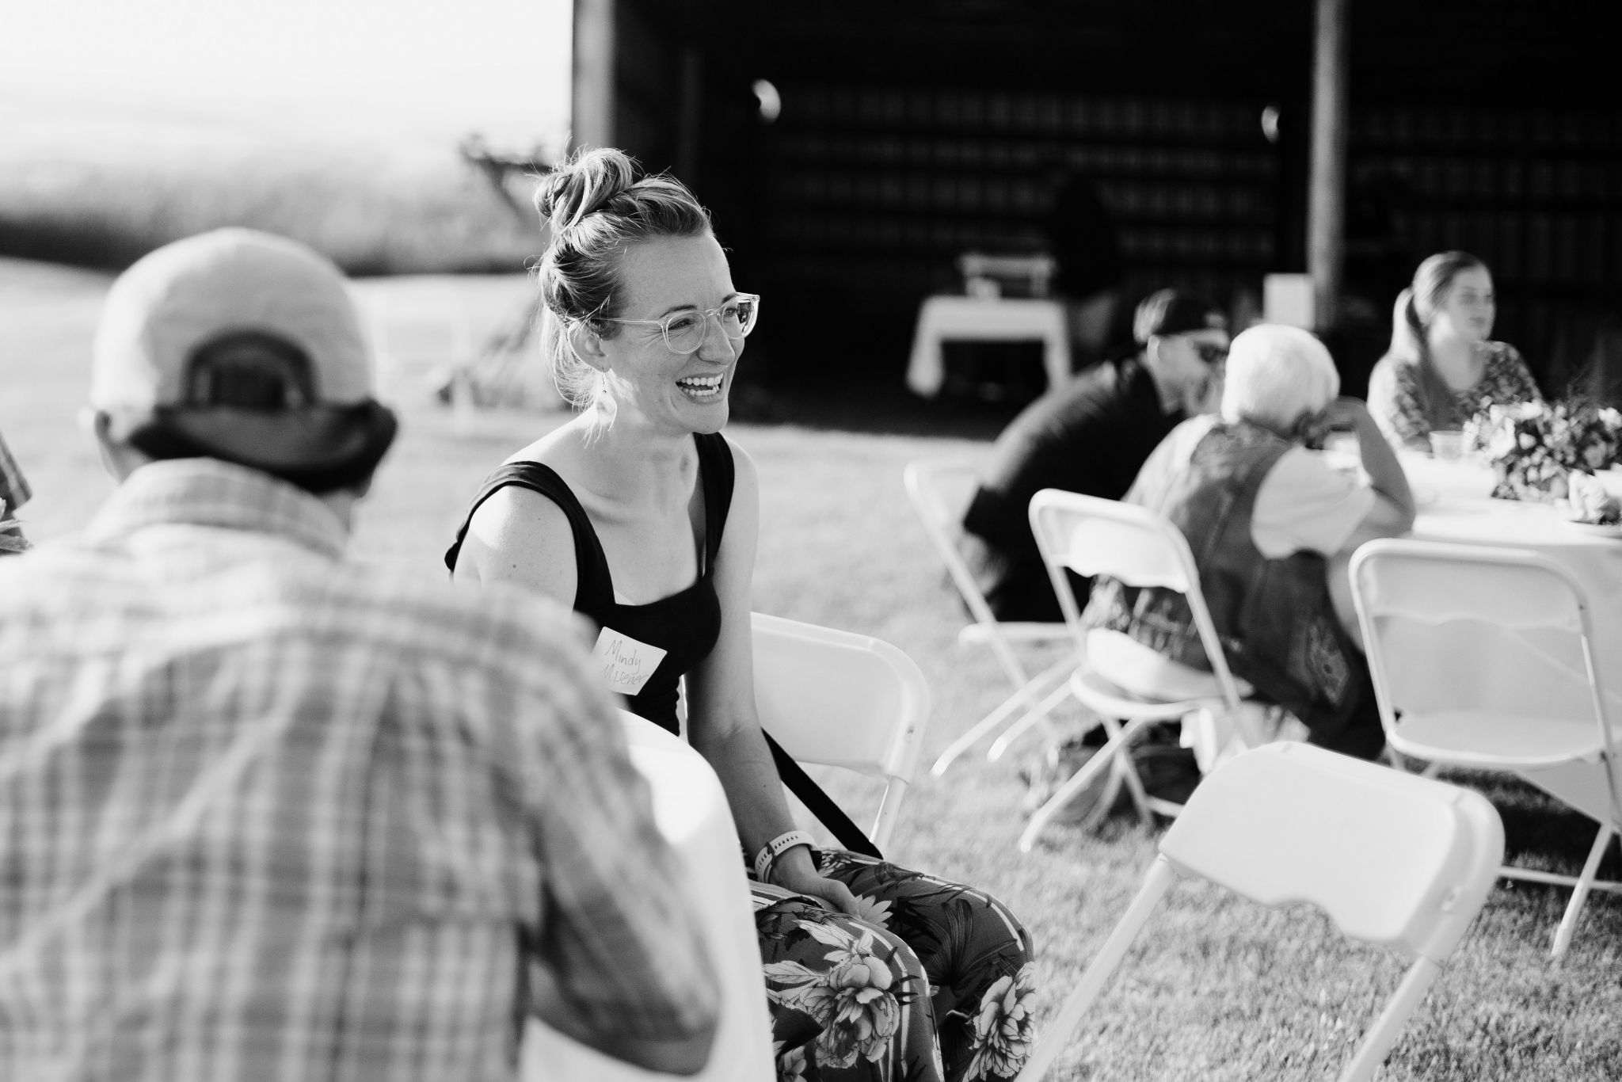
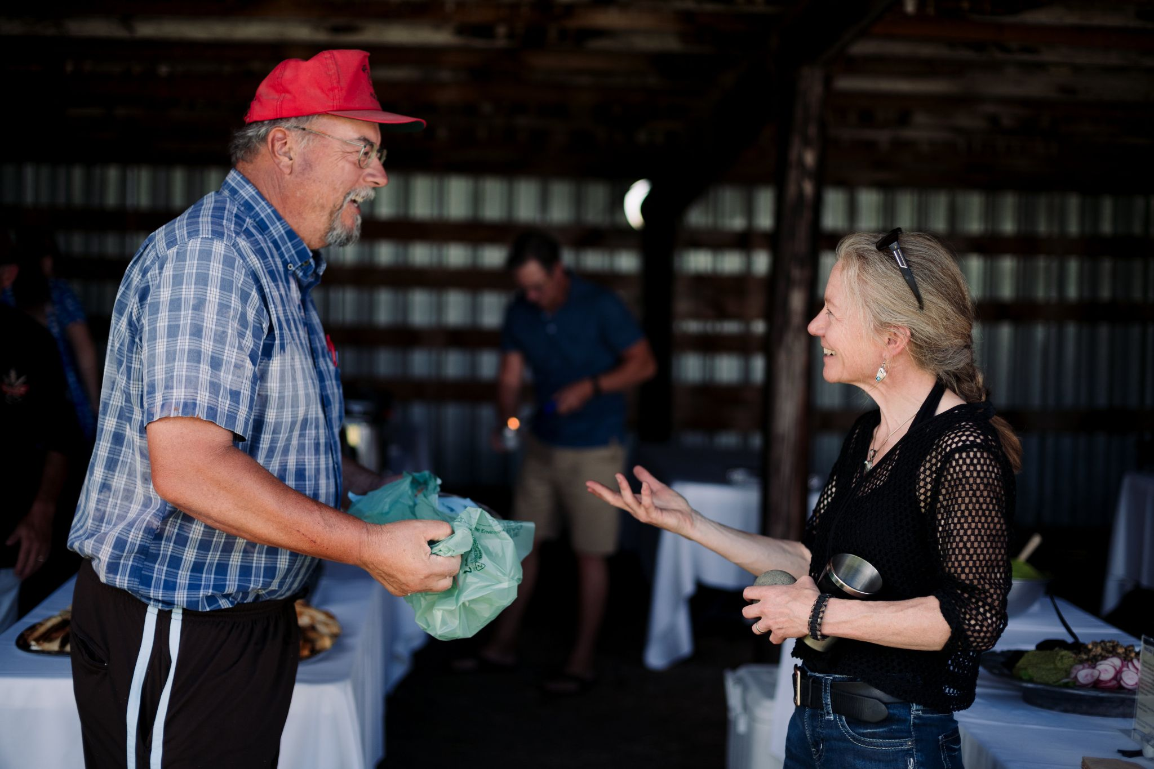
Collaboration

Slide 5
MFEI proposal:
Goal is to create a viable model for vegetable production that
(a) strengthens community by offering a meaningful opportunity to come together,
(b) increases food security and access to healthful local produce,
(c) increases understanding of food systems, and
(d) supports farmers who grow donated/discounted food for their community.

Slide 6
Gallatin Valley Botanical
Happel Family Farm
Gallatin Valley Land Trust
Gallatin Valley Food Bank
Open & Local
Montana Ale Works

Slide 7
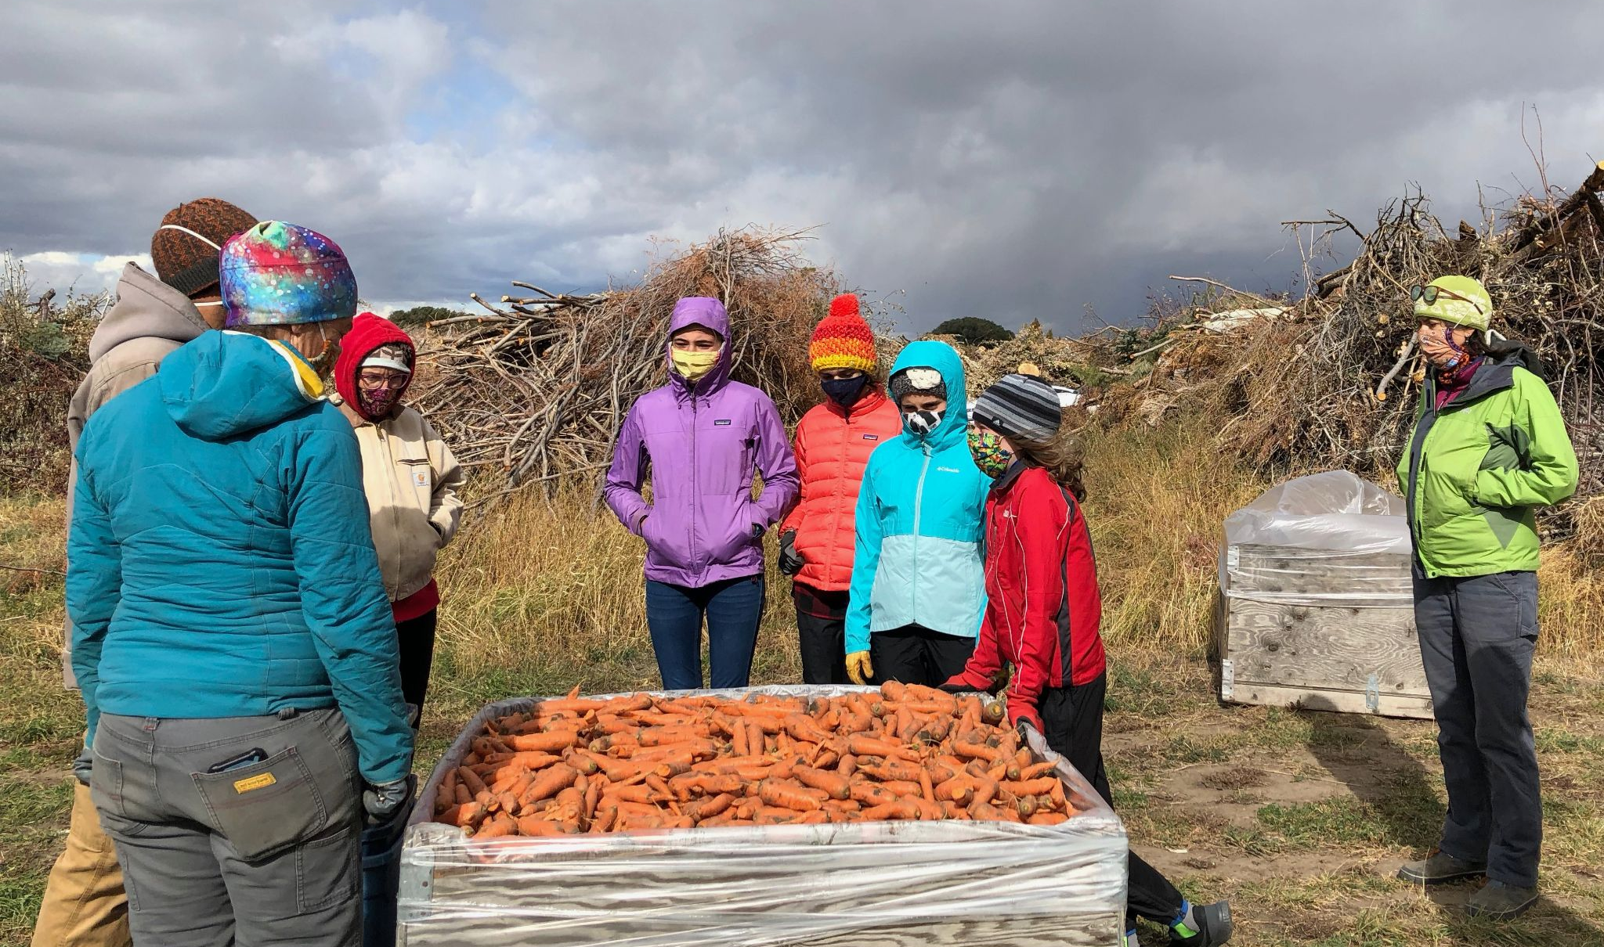
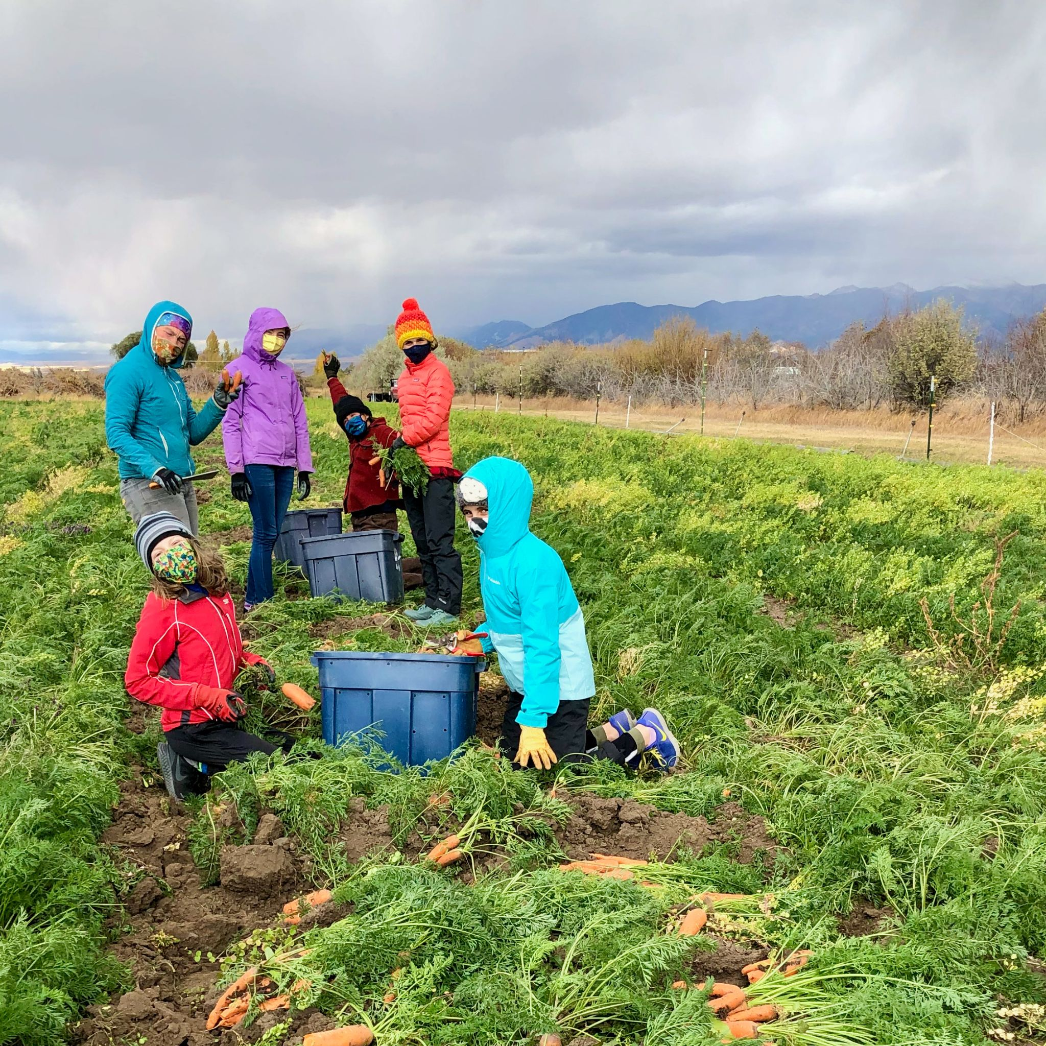
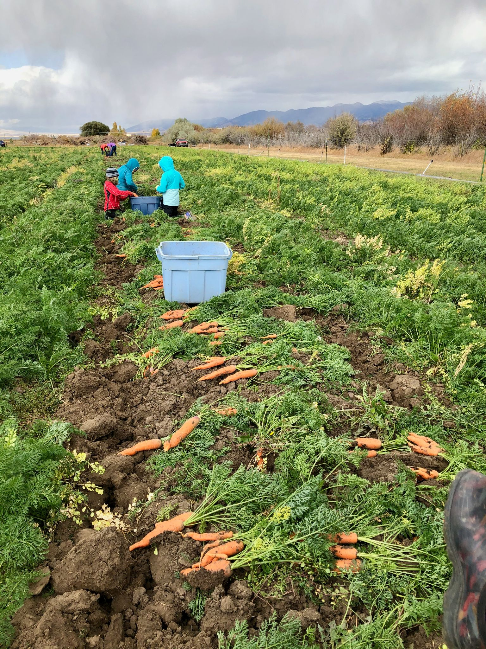
Students in school two days per week.

Slide 8
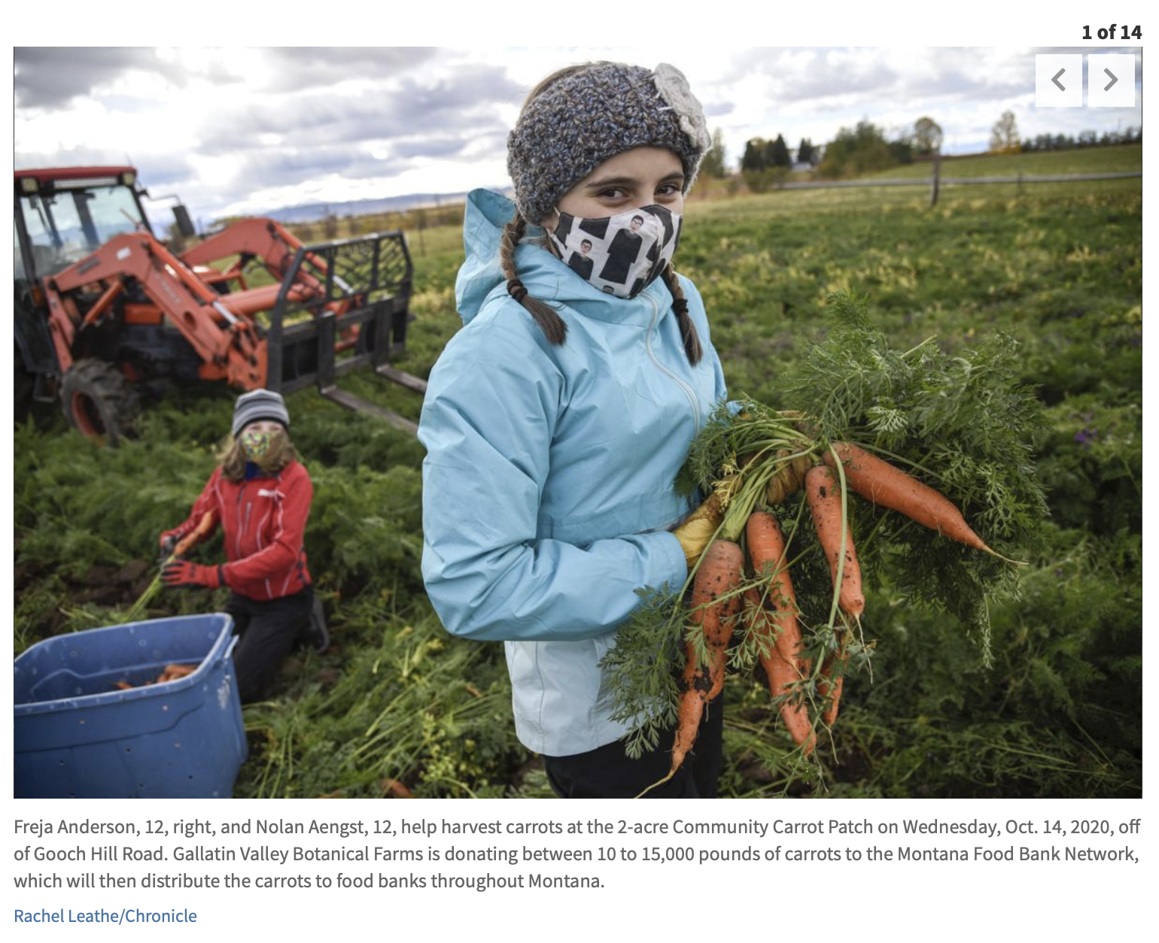
A local farm is donating carrots to the Gallatin Valley Food Bank, and the nonprofit that runs the food bank is looking for volunteers to help harvest the carrots.
...

Slide 9
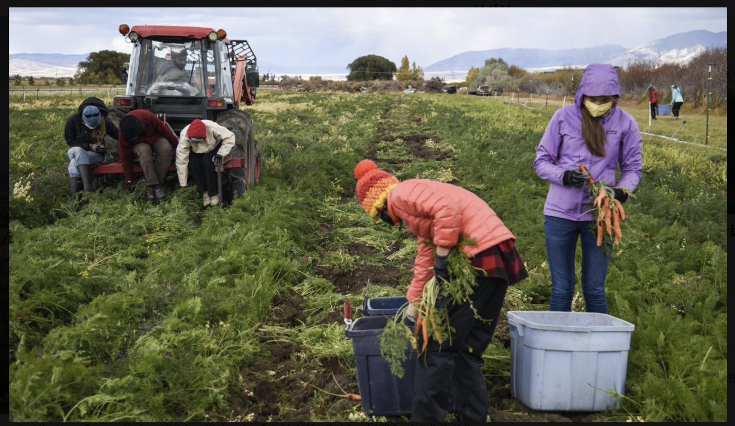
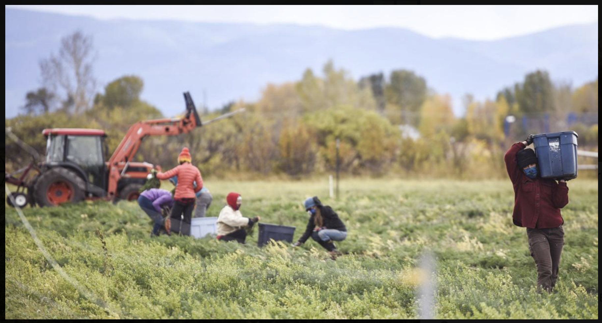
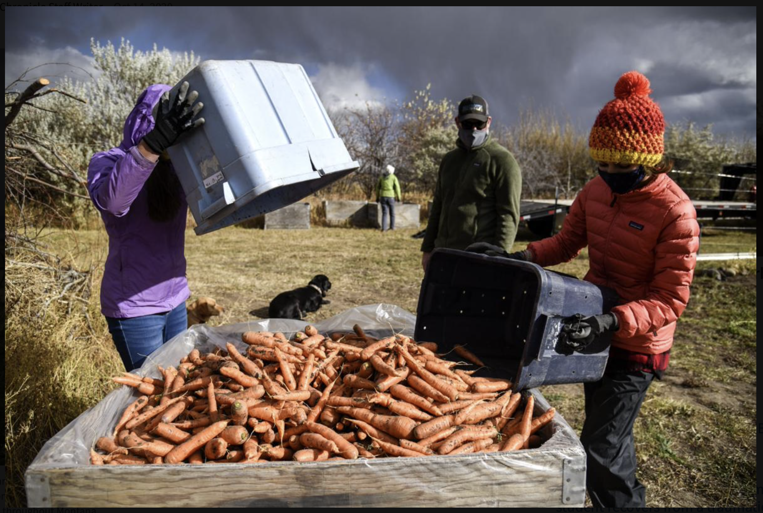
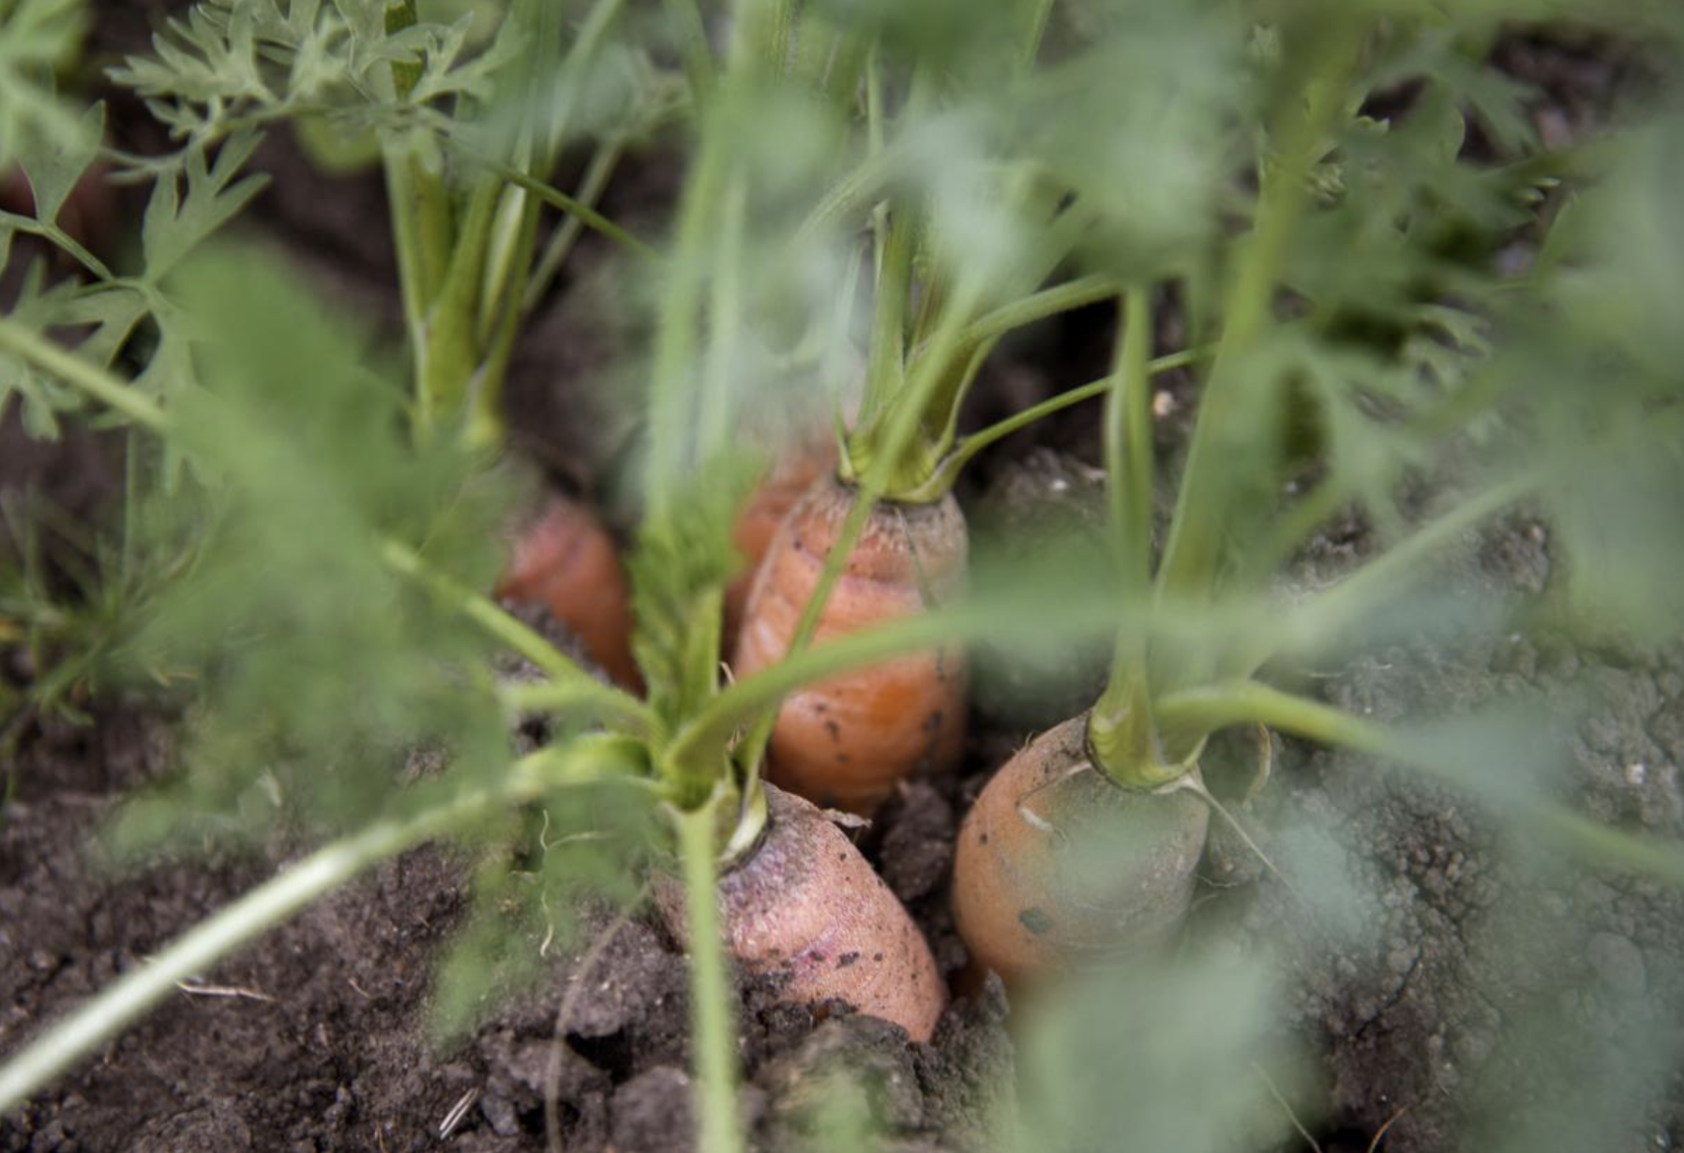
School groups
VISIONS Service Adventures
MSU Towne’s Harvest Garden
Montana Ale Works
Altitude Gallery
Individuals
these photos
NOT for sharing/
reproduction: from
Chronicle website

Slide 10
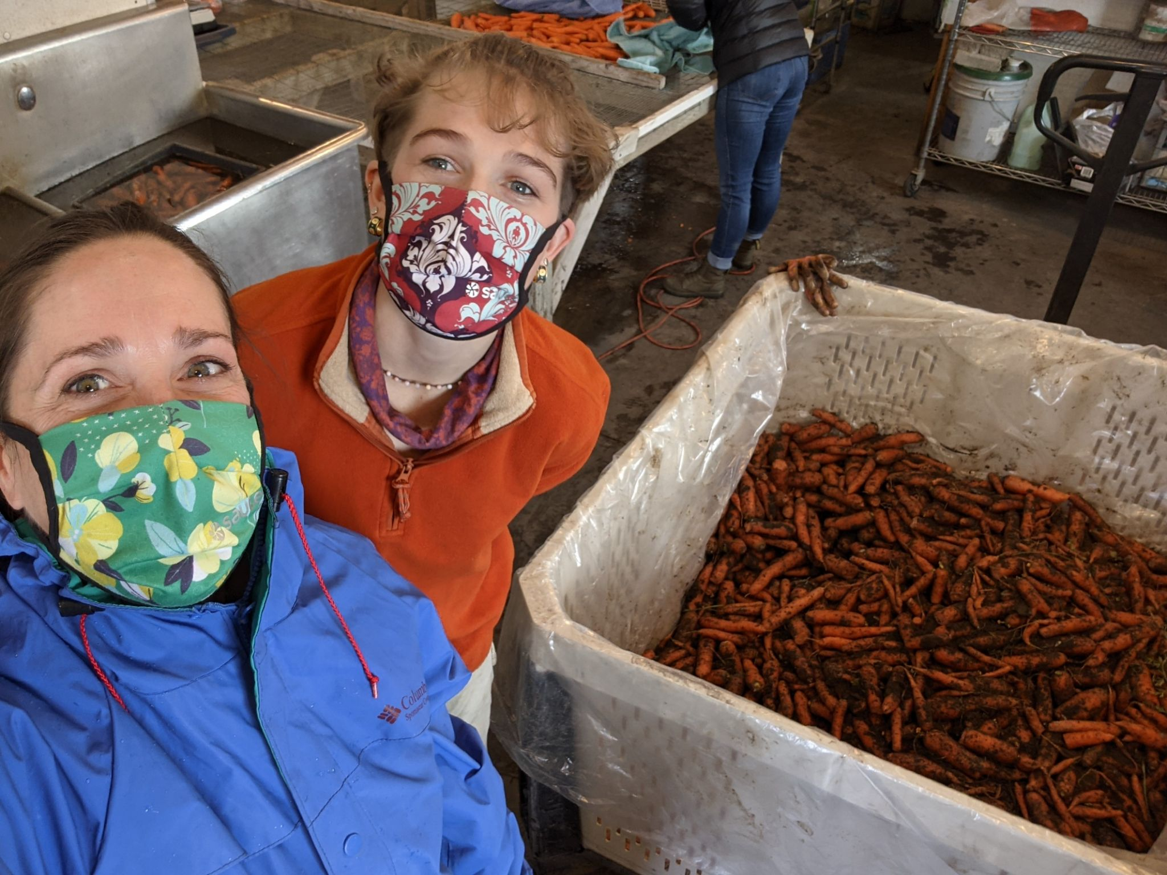
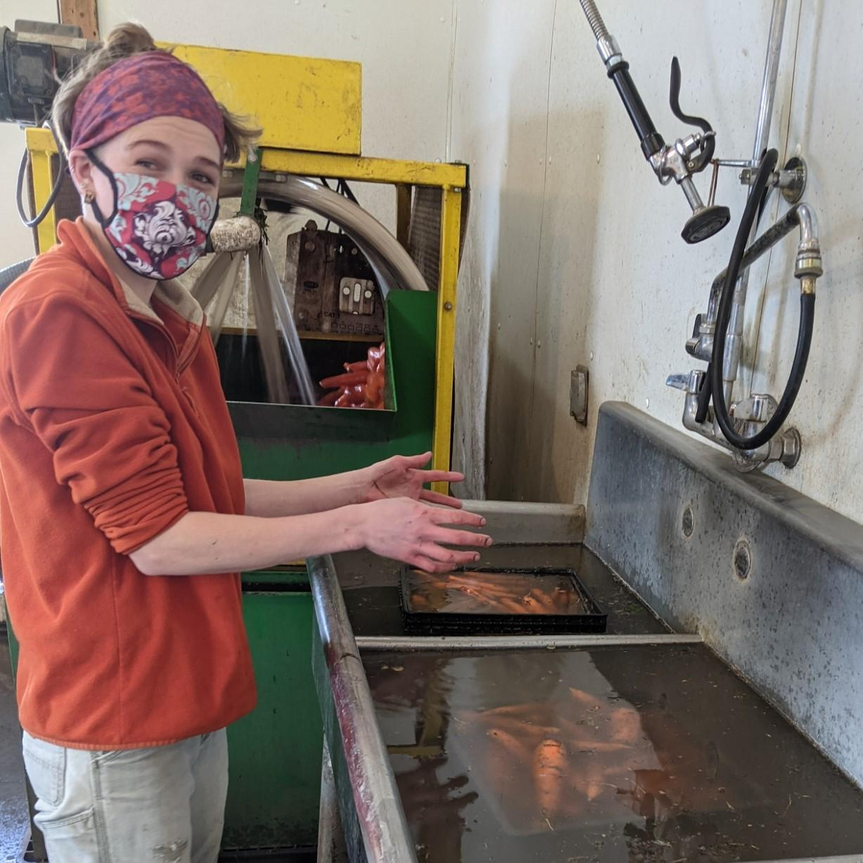
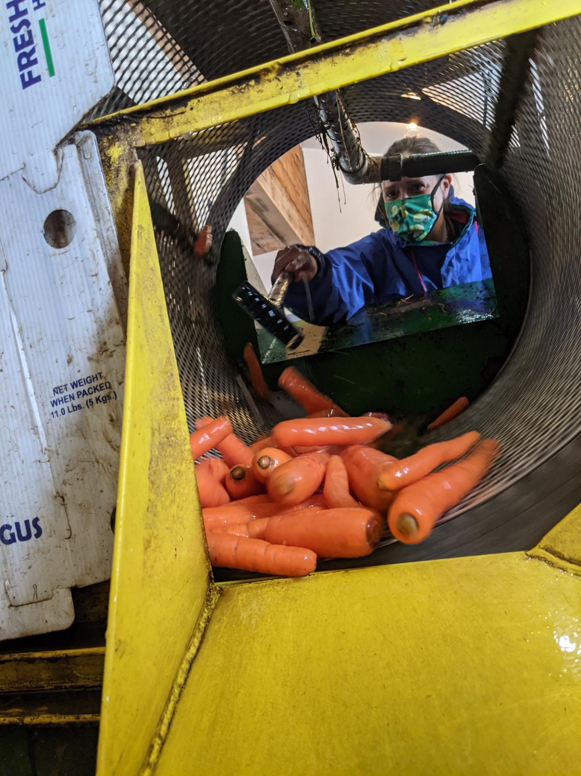
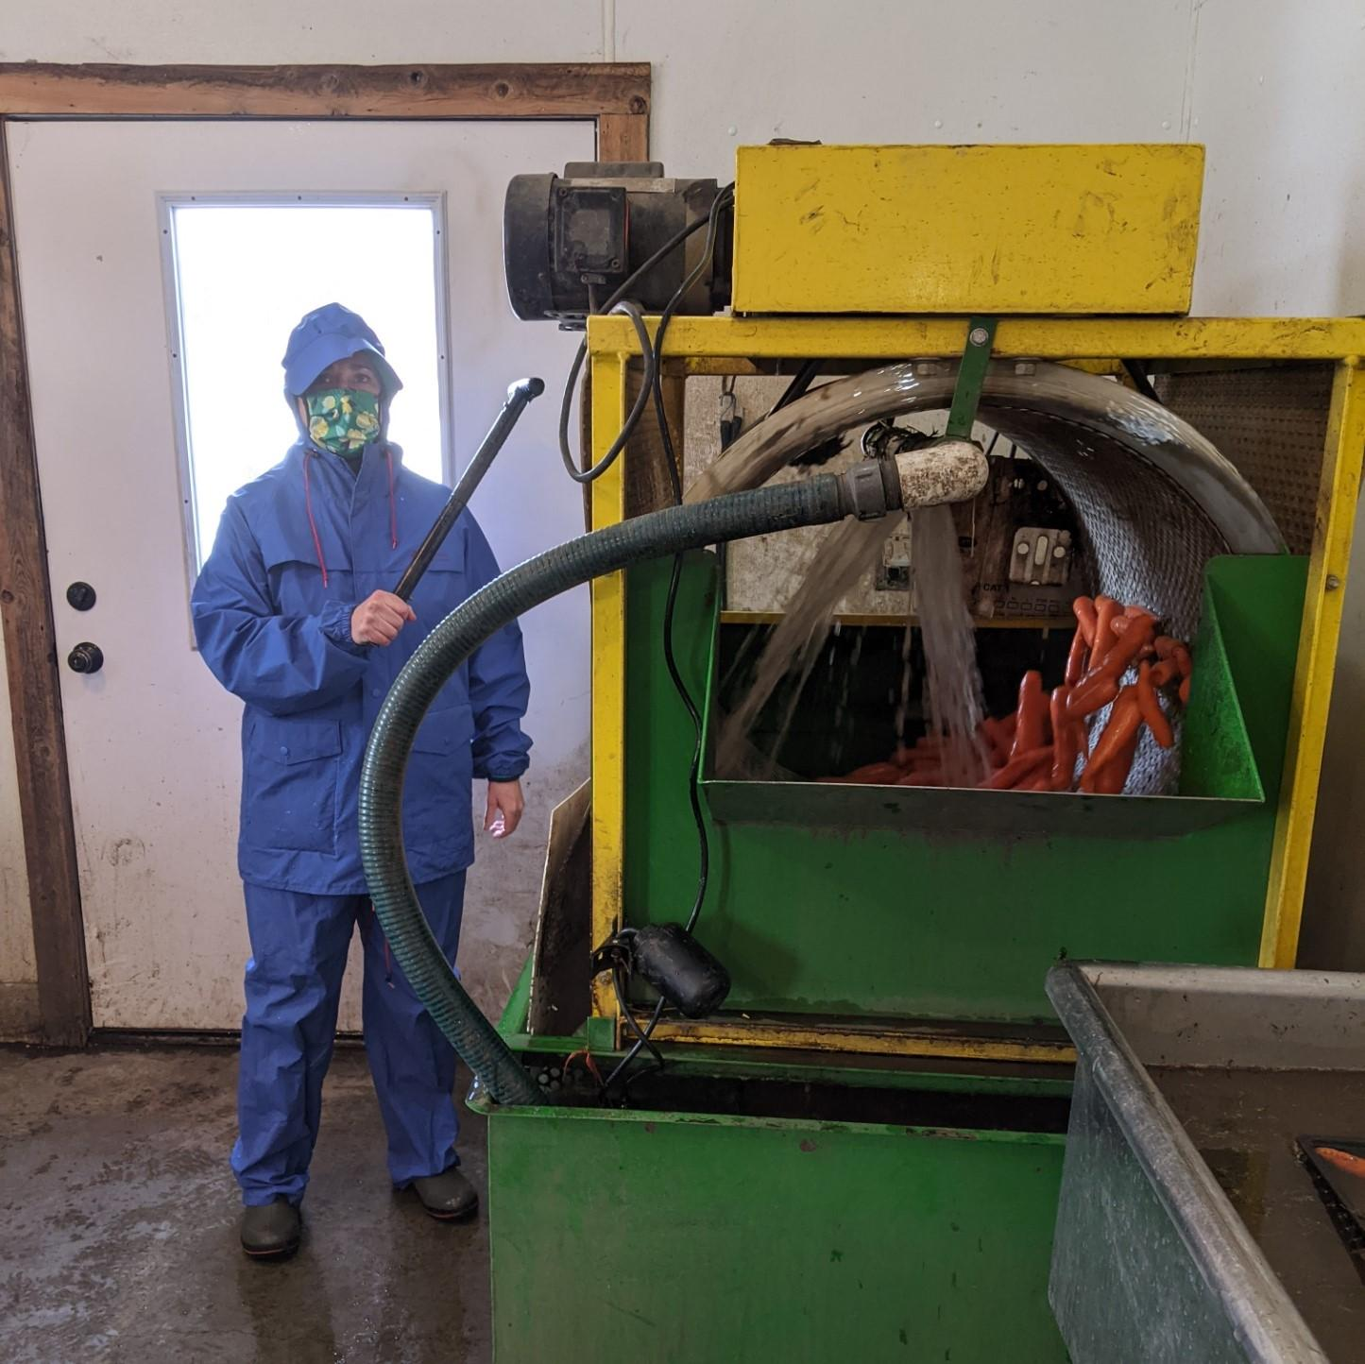
Altitude Gallery
– photos by Amy Kirkland

Slide 11
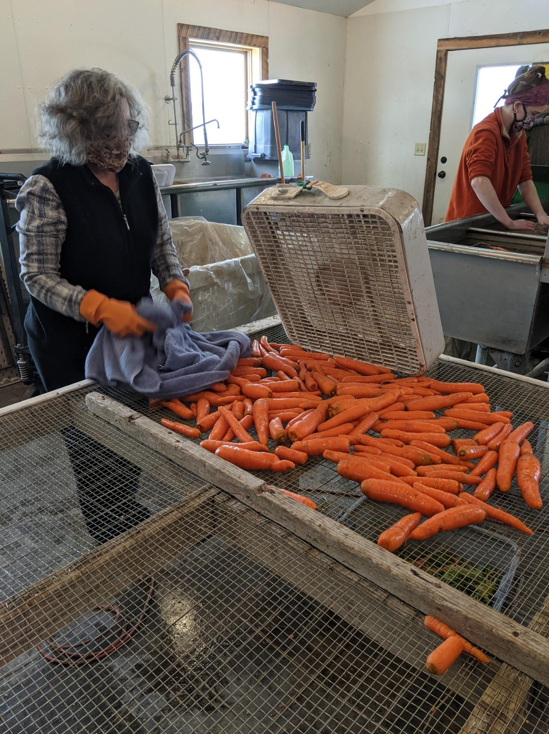
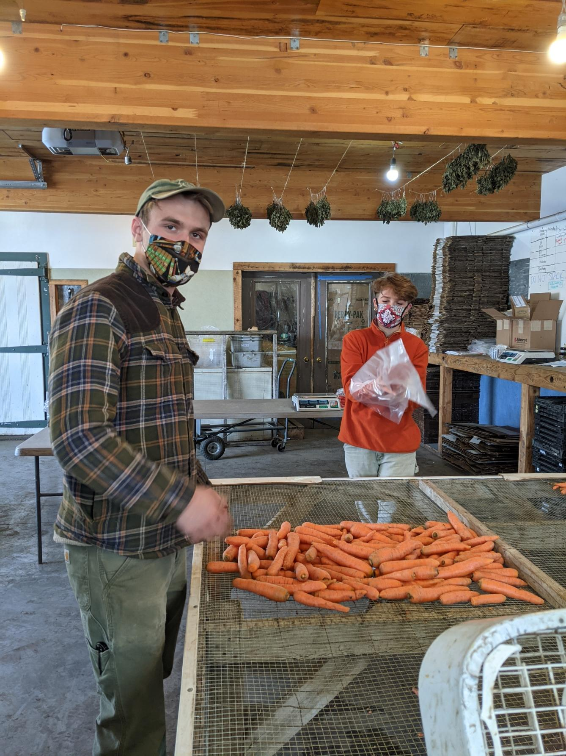
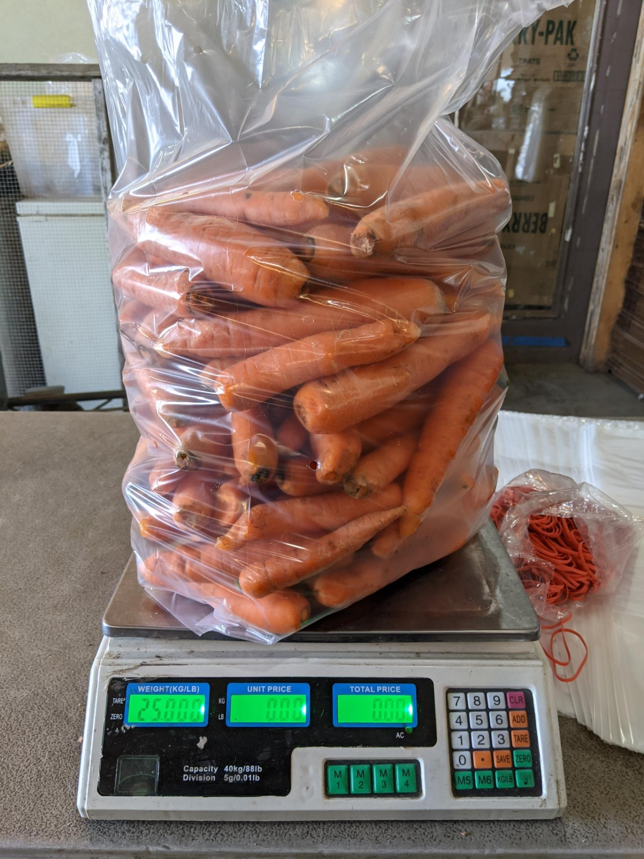

Slide 12
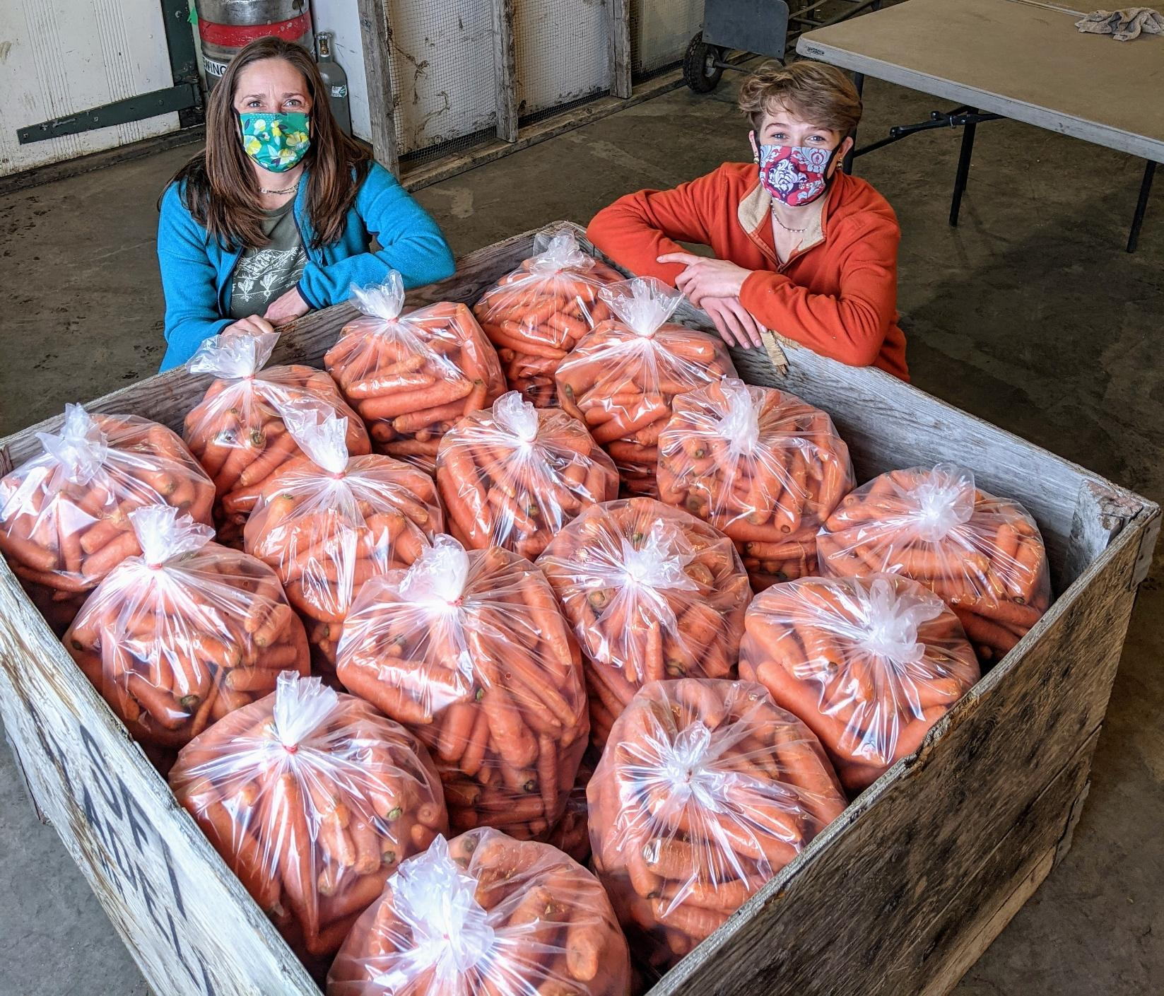
11,000# carrots donated
~725#/week, Nov—Feb
over 200 volunteers
~1,129 hours*
* does not include hours for planning, communication, volunteer coordination
budget
relied on donated equipment, services, volunteers...
rough value estimate: $8,646
re-think, re-design for 2021

Slide 13
2021 Community Harvest
GVFB purchasing crops directly from farmers
Community Harvest:
volunteer portal
groundwork to expand value chain pathways in 2022
purpose:
help grow food for vulnerable populations through partnership with Gallatin Valley Food Bank and other community entities
increase food literacy through hands-on volunteer opportunities,engaging people in the actual production of food for our community
build community centered around healthy, sustainable food and vibrant, resilient community food systems
Farms: Gallatin Valley Botanical, Towne’s Harvest Garden, and...

